Slide 1
Conditional Control Structures in Java
Week 3

Slide 2
Agenda
Recap of Last Lecture
Control Structures
Types of Control Structure
  Selection Control Structures
  Iteration Control Structures
  Jump Control Structure
Recap of the Lecture

Slide 3
Control Structures
Which change the flow of execution of java program.
Three types namely, selection, iteration, and jump

Slide 4
Control Structures
Selection statements allow your program to choose different paths of execution based upon the outcome of an expression or the state of a variable.
Iteration statements enable program execution to repeat one or more statements (that is, iteration statements form loops).
Jump statements allow your program to execute in a nonlinear fashion.

Slide 5
Selection Control Structures
Also called Conditional Control Structures. These control the flow of your program’s execution based upon conditions known only during run time.
Four types:
  if-else
  else if
  Nested if
  Switch Case

Slide 6
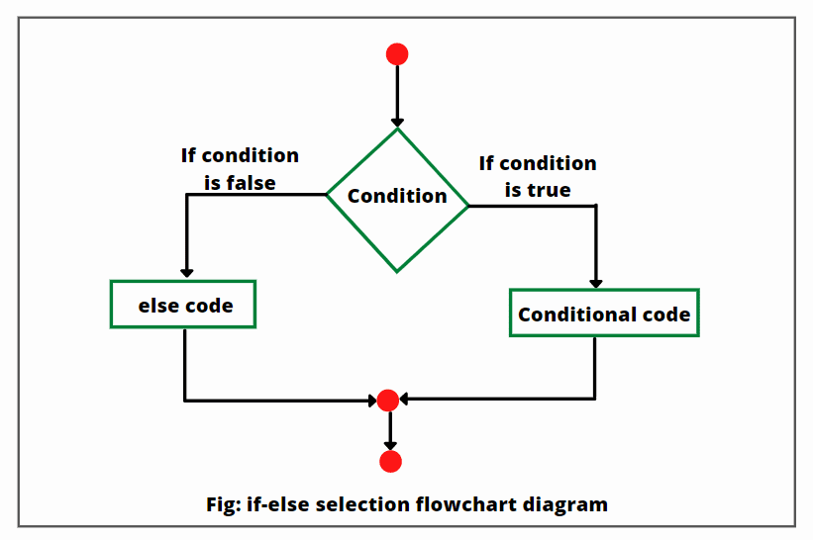
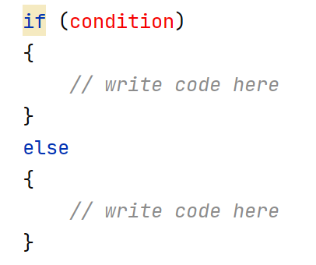
if-else

Slide 7
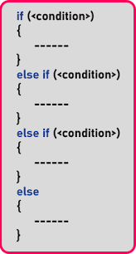
Else-If

Slide 8
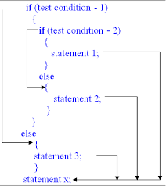
Nested If

Slide 9
Switch Case

Slide 10
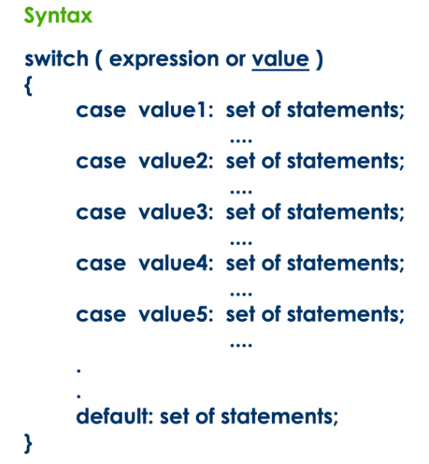
Switch Case

Slide 11
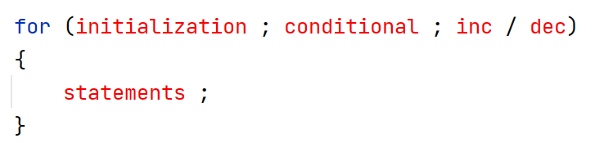
Iteration Statement: for loop

Slide 12
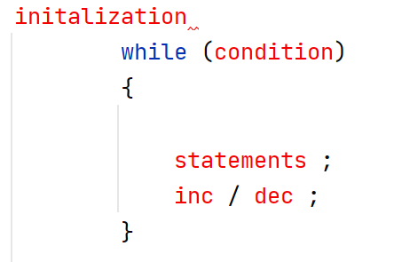
Iteration Statement: while loop

Slide 13
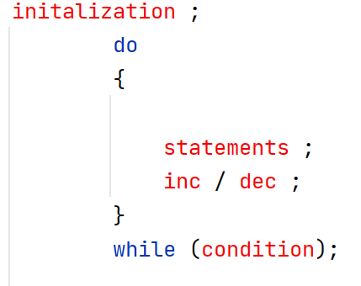
Iteration Statement: do while loop

Slide 14
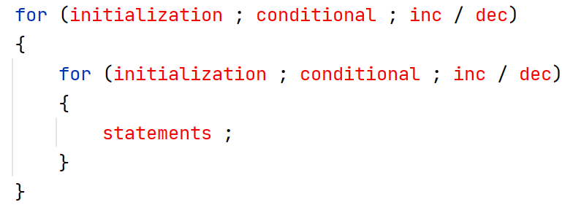
Iteration Statement: Nested Loop

Slide 15
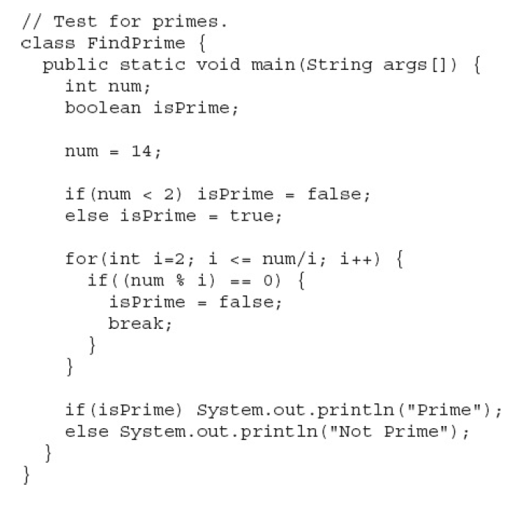
Iteration Statement: Prime or not

Slide 16
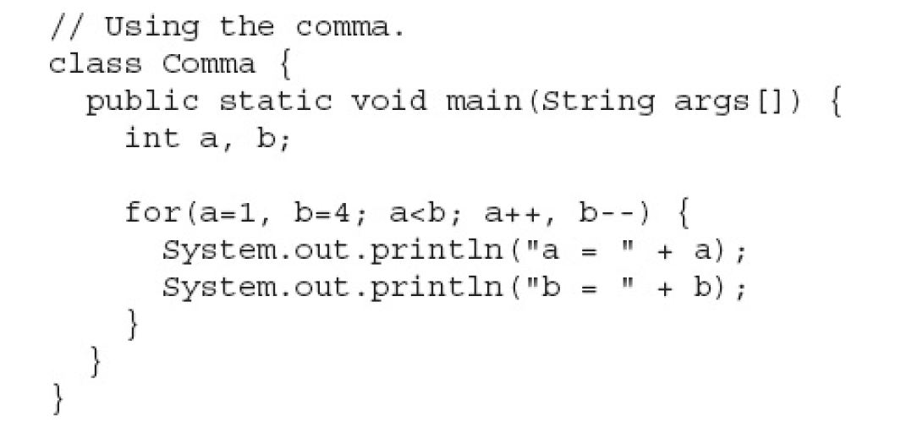
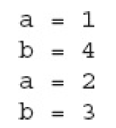
Iteration Statement: Using the comma for multiple initialization

Slide 17
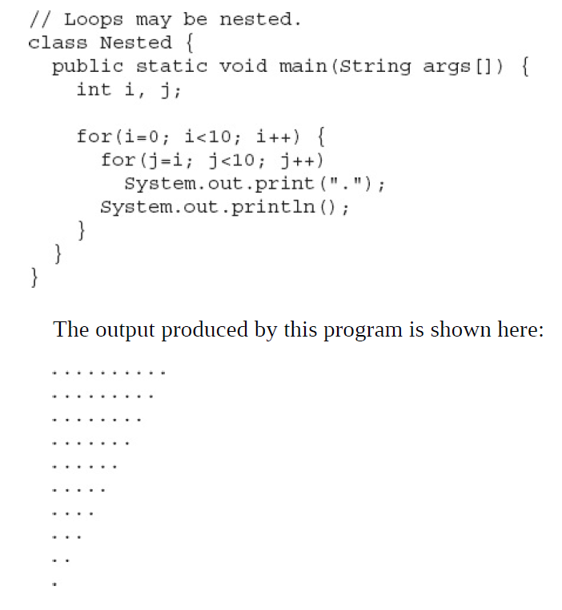
Iteration Statement: Using Nested Loop

Slide 18
jump statement
Java supports three jump statements: break, continue, and return.
These statements transfer control to another part of your program.

Slide 19
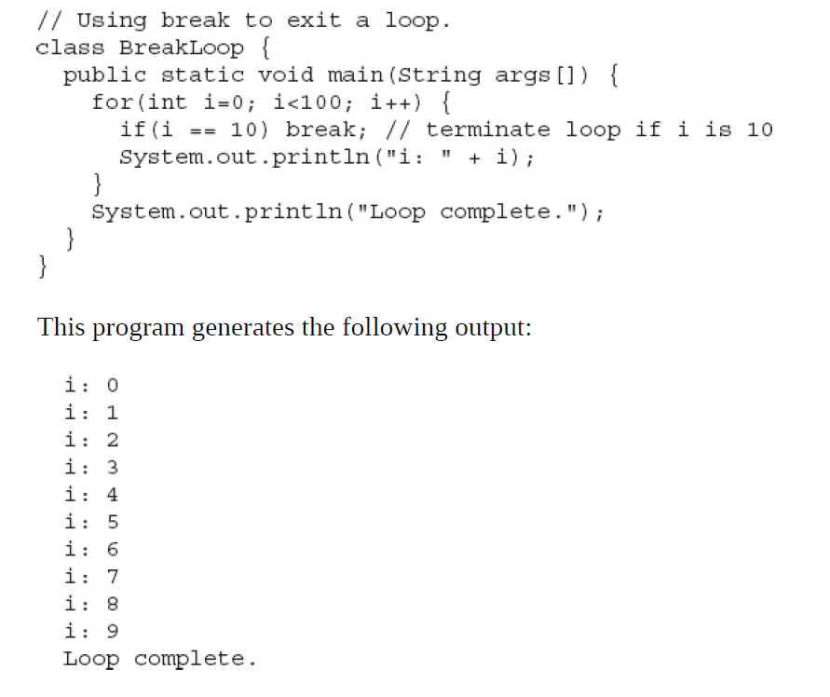
Break statement

Slide 20
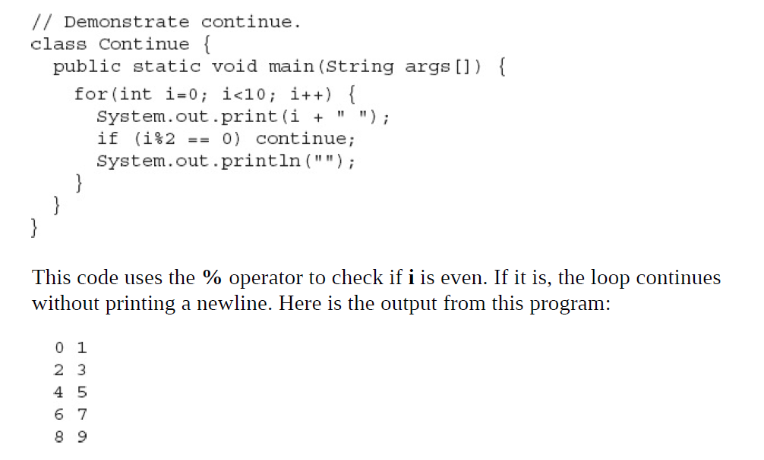
Continue statement

Slide 21
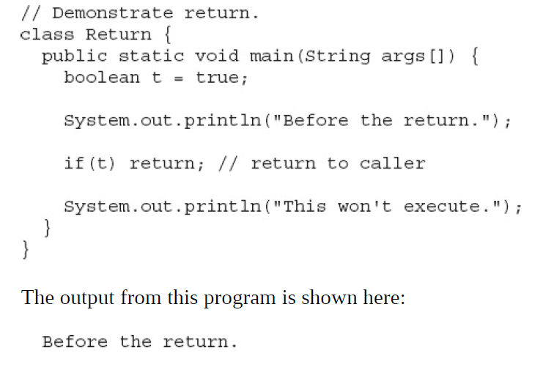
Return statement

Slide 22
Recap
Control Structures
Types of Control Structure
  Selection Control Structures
  Iteration Control Structures
  Jump Control Structure

